Slide 1
Davide Liga¹ , Sana Nouzri¹, Leon van der Torre¹⁻², Liuwen Yu¹ (1)-University of Luxembourg (2)-Zhejiang University
Legal and moral reasoning capabilities in intelligent machines
Marrakech – November 28, 2023
Notes:
For the evolving landscape of Artificial intelligence (Al), the law is a rich test bed and an important application field. While AI could be applied to the law in many ways, this talk explores the significance of both symbolic and sub-symbolic methodologies, emphasizing their indispensable roles in the application of AI to the law.
On one hand, Machine learning techniques have emerged as instrumental tools for many crucial tasks in Al & Law, such as norm mining, enabling the extraction of patterns and rules from vast datasets.
On the other hand, symbolic techniques such as logical argumentation techniques play a critical role in facilitating structured frameworks that underpin logical reasoning, offering clear and systematic approaches to decision-making in legal scenarios.
Moreover, the advent and evolution of Large Language Models (LLMs) have further transformed the Al landscape, offering not only new ways of dealing with complex legal scenarios, but also new possibilities for integrating symbolic and sub-symbolic Al.
Bridging the gap between traditional legal reasoning and the dynamic potential of the new generation of AI tools can set the stage for the next frontier in the intersection of AI and Law.

Slide 2
Layout
Normative reasoning and argumentation with legal texts
New developments in mining arguments and Norms
Notes:
So now I want to explain some of the development in the MIREL pipeline, and I will start at the last step, the reasoning. From my perspective, I will first discuss some recent development relevant for this talk, then I move to the main challenges from the perspective of reasoning, namely mining, integration, and decision making. I will also make an advertisement for the new handbook on legal AI.

Slide 3
PART I
Normative reasoning and argumentation with legal texts
Notes:
max 2m

Slide 4
Why norms and arguments?
They are the main logical-inferential structures through which (legal) reasoning can be instantiated
(and the instantiation is generally made into natural language)
Communities reasoning in AI&Law about norms & arguments
DEON
COMMA
ESSLLI

Slide 5
DEON (1991-)
Biannual conference
Since 1991: deontic logic in computer science
Since 2014: deontic logic and normative systems
Highly interdisciplinary: linguistics, law, ethics, philosophy, computer science, artificial intelligence, …
Notes:
So let’s start with the background of legal reasoning. This concerns different academic disciplines, and an important one for our work is the DEON community.

Slide 6
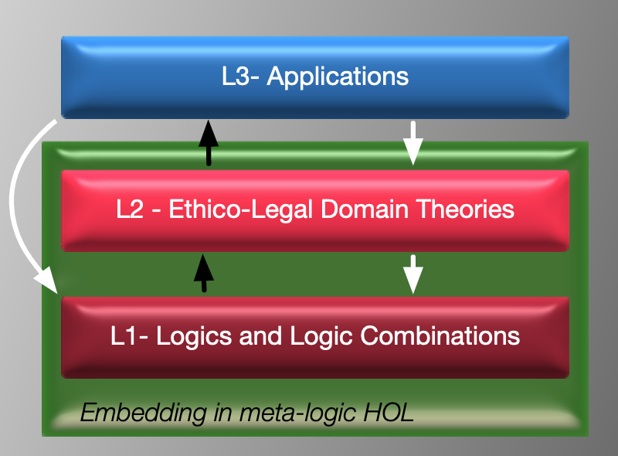
LogiKEy (2020)
Logic and Knowledge Engineering Framework and Methodology
Experimentation
Recent trend: “data sets”
Notes:
One important development in the DEON community is the LogiKEy methodology, which we developed over the past years. On top of the deontic logics and normative systems there is a layer of ethico-legal theories, which can be used for various applications. LogiKEy stands for Logic and Knowledge engineering framework and methodology, it is used fpr experimentation with formal reasoning systems, and it comes with datasets, like the one mentioned here. This is a dataset of logical “embeddings”, not the usual corpus or ML dataset.

Slide 7
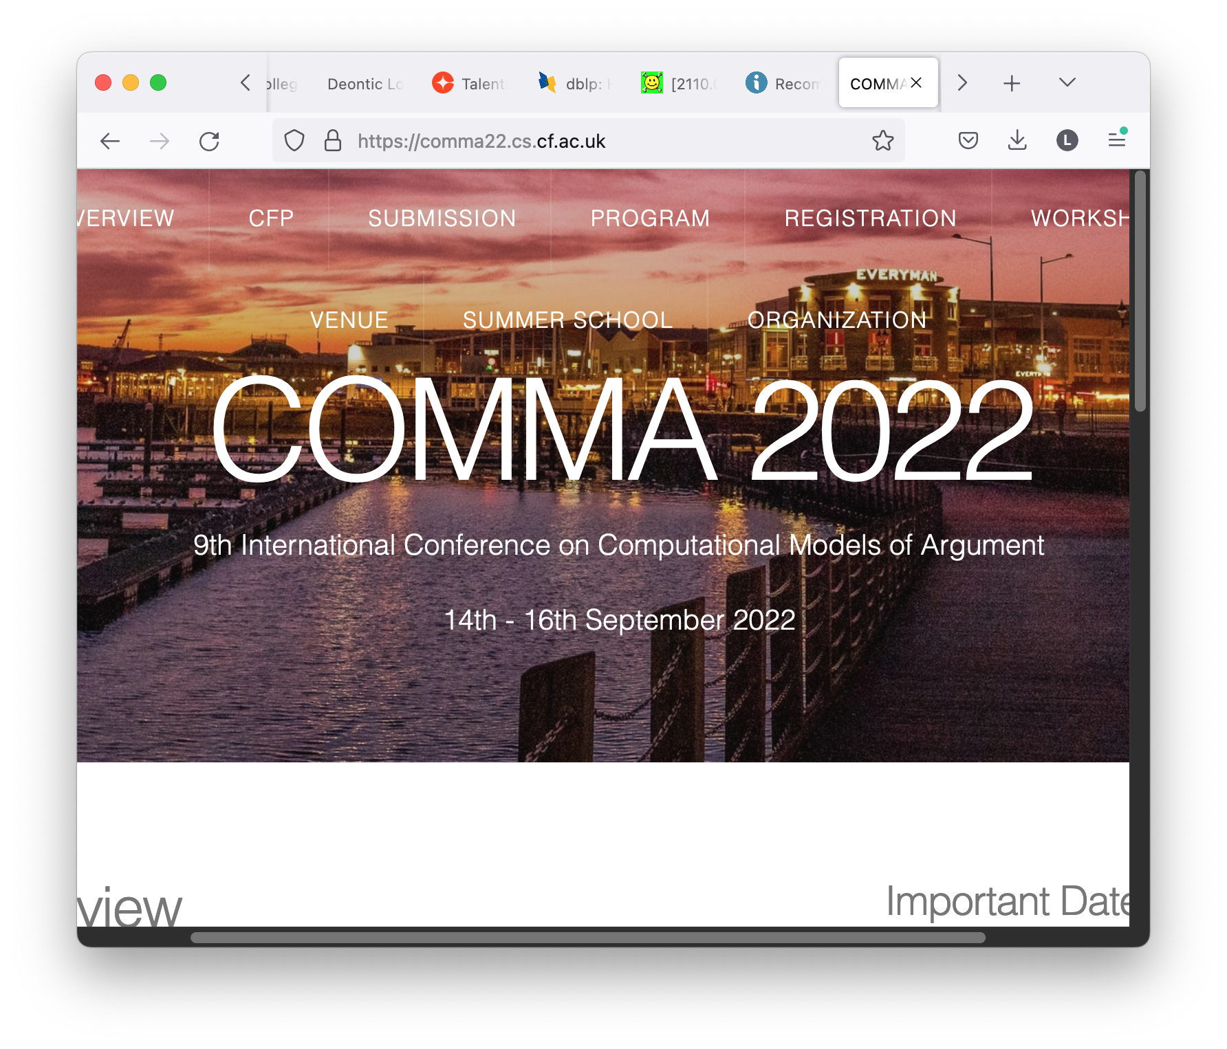
COMMA
Computational models of argument
Notes:
The second community is COMMA. Over the past three years, many new semantics for ambiguitiy blockin int the formal argumentation community, : introduction in Madeira 2019, AAAI2020, best paper award at KR2020, COMMA2020,…

Slide 8
vBerkel, vdTorre & Gabbay. If you want to smoke, don't buy cigarettes: near-anankastics, contexts, and hyper modality
Dr. Smoke wanders through the university’s inner courtyard. Prof. Prag- matics notices a slight disturbance in Dr. Smoke’s mood. She asks him: “what’s on your mind?” Smoke shares with her his craving for a cigarette. Prof. Pragmatics replies “if that is so, then you must go to the tobacco shop!” At that moment, Prof. Restraint crosses the lawn and, by chance, catches Pragmatics’ last remark. Restraint asks: “what is going on here?” Pragmat- ics: “He wants a cigarette!” Prof. Restraint looks surprised: “if that is the case,” she exclaims, “then you surely should not go to the tobacco shop. ”
Pragmatics formalized using Dov’s hyper modalities at DEON 2020/21
Notes:
Cleo Condoravdi was working a decade ago on Anankastic conditionals, and with Kees van Berkel and Dov Gabbay we showed last DEON how we can formalize these pragmatic aspects using Dov’s so-called hyper modalities.

Slide 9
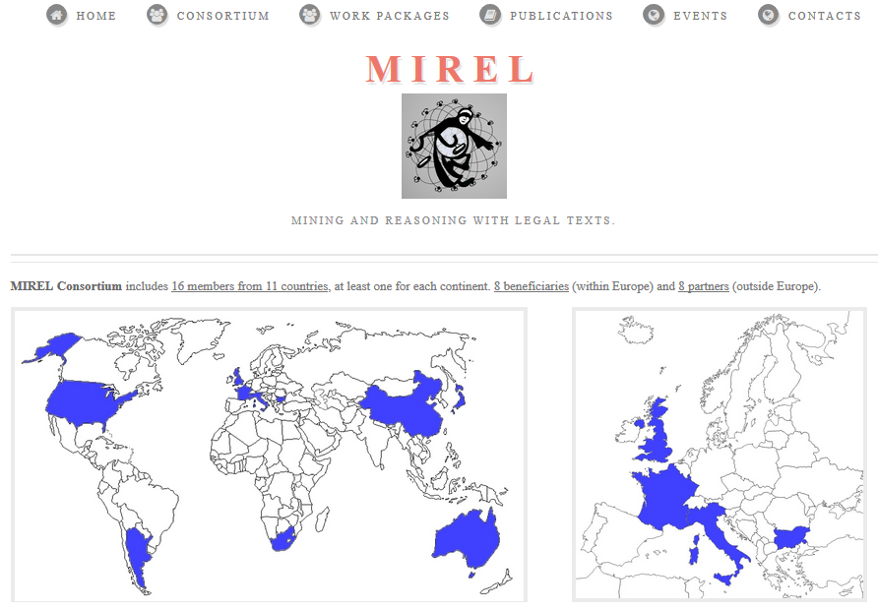
H2020 Marie Curie RISE project (2016-2019)
RISE = “Research and Innovation Staff Exchange project”, EU funding provided for exchange visiting secondments
16 participants (3 industrial)
Bridging Mining and Reasoning within the legal domain
http://www.mirelproject.eu
Notes:
I was the PI of the MIREL project, an FP7 project that aimed to go beyond the borders of the EU with partners in Stanford, China, Japan, Australia, but also with less developed countries like Argentina, South Africa, and industrial partners.

Slide 10
Legal Informatics and Society (2016)
In an internationalised environment, the amount of legal information, from legal corpora to case law, is often overwhelming.
The European Union is an exemplary case:
multiple levels of legislations that must
coexist,
develop, and
be applied consistently.
2
Notes:
This is what we wrote in 2016. The EU is the prime example of an important development in law, namely that it becomes less national and more international.

Slide 11
Legal Informatics and Society (2016)
Multiple problems to face.
Examples:
Identification and resolution of anomalies and conflicts among different legal documents.
Law drafting negotiations between multiple heterogeneous entities.
Normalisation in the interpretation and application of the laws.
Norm enforcement and compliance.
The use of Artificial Intelligence technologies allows the development of automated tools that can help Legislators, Lawyers and Companies to ease and rationalise the processing of legal information.
3
Notes:
The increasing internationalization and complexity of the law domain leads to many problems, of which AI may be part of the solution.

Slide 12
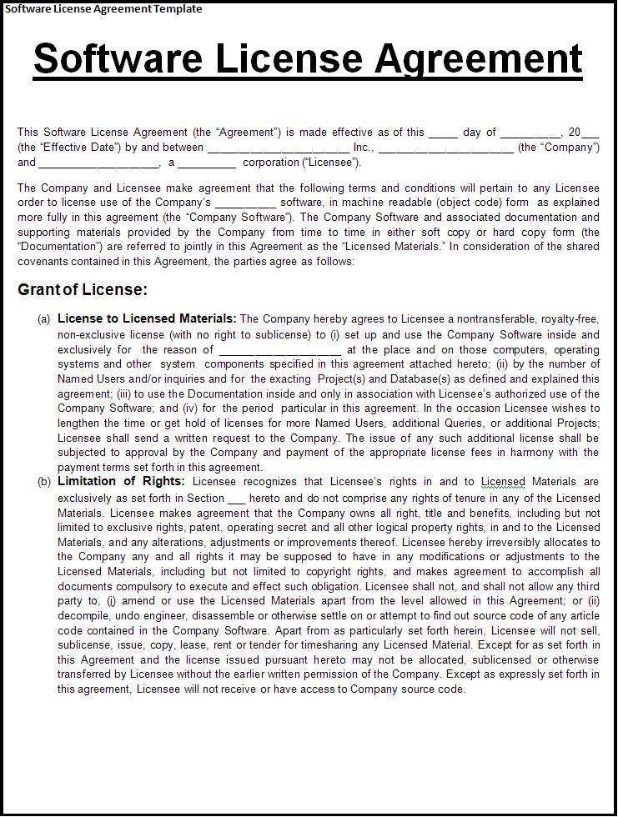
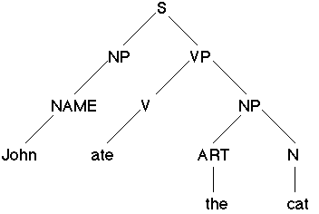
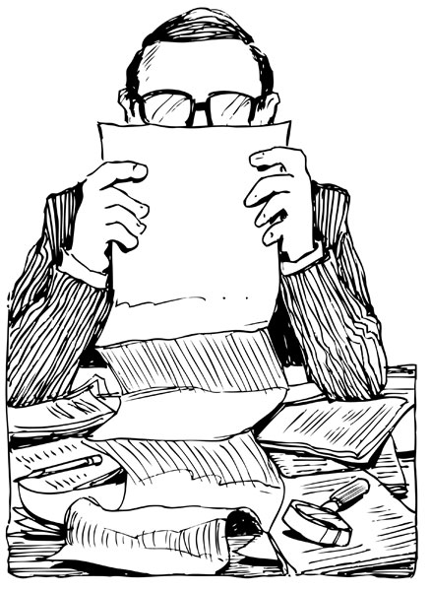
MIREL pipeline (2019)
Machine-readable representation
Automatic reasoner
Legal text
mining
reasoning
Structure?
Consequences?
Obligations?
Permissions?
Consistence?
Compliance?
Time constraints?
Sub-licensing?
Notes:
The main issue in AI&Law in those days was the integration of methods developed for legal texts, and methods for legal reasoning. The solution proposed in the MIREL project is the MIREL pipeline, which will play a central role in this talk.

Slide 13
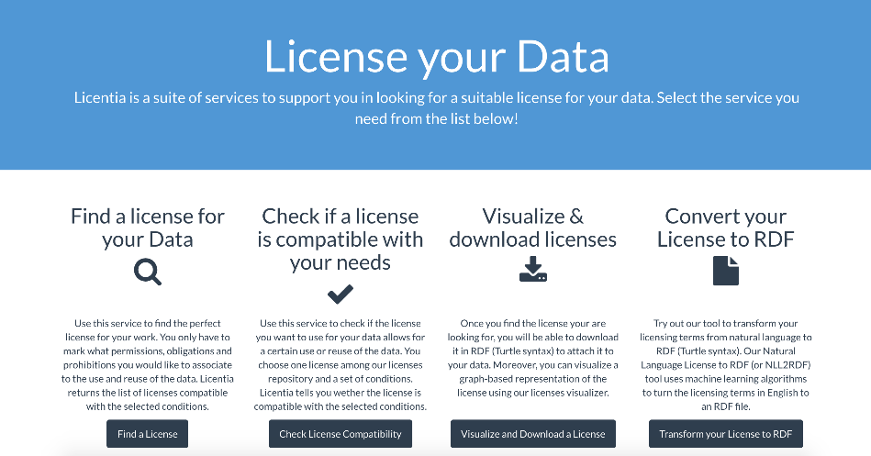
Example in France (2019)
A suite of services developed at INRIA to support data producers and publishers in data licensing.
A user-friendly interface that masks to the user the complexity of the legal reasoning.
Licentia 2.0 allows to:
Compose a license by selecting keywords through the interface.
Check if a certain action is compliant with a given license.
Licentia 2.0
Notes:
Here is an example of my former PhD student Serena Vilatta and her team, then at INRIA (now at CNRS). Starting from her PhD in formal argumentation, she moved to argumentation mining in her current research in Nice.

Slide 14
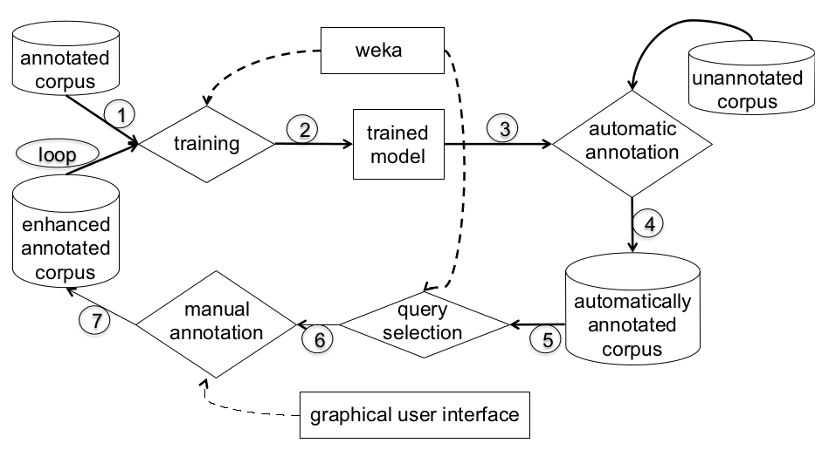
Example in France (2019)
A new version of Licentia has been released in the context of MIREL.
Licentia 2.0 integrates a new service whose aim is to translate natural language licenses into RDF ones, where in particular obligations, prohibitions and permissions are highlighted.
This has been achieved via an Active Learning approach developed at the University of Cordoba.
The architecture of Licentia 2.0
Notes:
The novelty here is a translation from licenses in natural language, to licenses in RDF, a popular language in the semantic web.

Slide 15
Handbook of Legal AI (the MIREL book), to appear
Notes:
The MIREL project led to the first volume of the handbook of legal AI.

Slide 16
Handbook of Legal AI (the MIREL book), to appear
Notes:
The MIREL project led to the first volume of the handbook of legal AI.

Slide 17
Handbook of Legal AI (the MIREL book), to appear
Notes:
Another connection to law department of Toulouse I did not yet talk about, with Lucien Rapp

Slide 18
College publications

Slide 19
PART II
New developments in mining arguments and norms
Notes:
arguments and norms are crucial elements for reasoning

Slide 20
PART II Symbolic & Subsymbolic
The biggest dichotomy in AI
Symbolic vs and Sub-symbolic
(rule-based)
(connectionist/data-driven)
The Holy Grail in AI will always be one:
find the right methods to merge these two worlds

Slide 21
PART II Symbolic & Subsymbolic
Symbolic AI focuses on using symbols, logic and explicit rules to represent knowledge, solve problems and make decisions.
Sub-symbolic AI employs techniques like neural networks and deep learning to model complex patterns and learn from data.

Slide 22
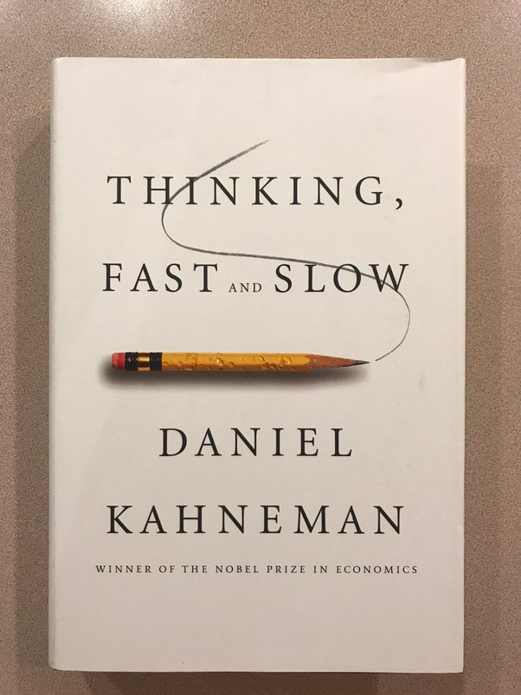
System 1 vs System 2
The "System 1" and "System 2" describe two ways of thinking.
It is a theory from cognitive psychology proposed in the famous book by Daniel Kahneman.

Slide 23
System 1 thinking
Fast, automatic, intuitive, effortless, and emotional thinking.
It is responsible for quick decision-making and pattern recognition, often relying on heuristics and biases.
This system is similar to sub-symbolic AI, as it deals with learning (and generalising) from data

Slide 24
System 2 thinking
Slow, deliberate, logical, and analytical thinking.
It is responsible for complex problem-solving, planning, and reasoning based on rules and explicit knowledge.
This system is analogous to symbolic AI, which focuses on using symbols and logic to represent knowledge and solve problems.

Slide 25
道
道
TAO (道) is “the way”
The way
Integrating both types of AI methods can lead to more effective and human-like AI systems, just as human cognition benefits from the interplay between System 1 and System 2 thinking.
Notes:
Max5min

Slide 26
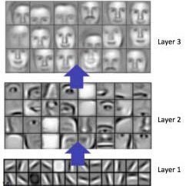
PART II Symbolic & Subsymbolic
Symbolic features seem emerging from sub-symbolic latent spaces
Notes:
max6

Slide 27
Reasoning vs Mining

Slide 28
(Legal) Natural
Language
⚠️
Uncertainty
Variability
Inconsistency
Incompleteness
?
NLP
Argumentation
Argument
Mining
Logic
Logical/Inferential
Dimension
Reasoning vs Mining

Slide 29
Challenge: Legal code is in natural language
Solution: natural language processing and LLMs
we can detect logical-inferential structures from text (=Arg.Mining)
We already applied some NLP work to two crucial types of logical-inferential structures: Arguments and Rules
Using transformer-based foundation models (BERT, GPT), and ML
Notes:
challenge: legal code is written in natural language (which is ambiguous, and can be an obstacle for legal ADM)
solution: the revolution in natural language processing over the past few years
NOW we can interact with language a process it, and extract knowledge from it in an easier way

Slide 30
Some works on mining
- Arguments
- Norms
Notes:
max 10m

Slide 31
Some works
Regarding arguments:
We trained ML to recognise Argument Schemes, which are located halfway between language and logic.
Arg. Scheme from XXX
Text
Machine Learning
(Text Classification)
Output class
Notes:
First consider a legal arguments. Davide used a very important theory here in philosophy, namely the theory of argument schemes.

Slide 32
Some works
References:
Walton, Macagno and Reed 2008, “Argumentation Schemes”
Liga 2019, “Argumentative evidences classification and argument scheme detection using tree kernels” (ArgMining, ACL 2019)
Liga 2020, “Transfer Learning with sentence embeddings for argumentative evidence classification” (CMNA, COMMA 2020)
Liga 2020, “Argumentation Schemes as Template? Combining bottom-up and top-down KR” (CMNA, COMMA 2020)
Premise 1: E is an expert of domain D
Premise 2: E says that statement S (which is in domain D) is true
Conclusion: Therefore, S is (presumably) true
!
Hidden warrant: if an expert says something in his domain, it must be true
Notes:
Importantly, some premises can be missing sometimes, including the wain warrant. Note that with “must be” we mean “must presumably be true”. We are in the domain of defeasibe and presumptive reasoning.

Slide 33
Some works
References:
Shoreh H. 2022, PhD thesis
Liga 2022, hybrid artificial intelligence to extract patterns and rules in argumentative and legal texts (PhD thesis)
Liga 2022, Argumentative Sequence Labelling using Transfer Learning (forthcoming publication)
Regarding arguments:
We trained ML to mine argument components (e.g., premises and claims)
Bla bla bla, bla bla, bla bla bla
Premise
Claim
Text
Machine Learning
(Sequence Labelling)
Notes:
Another key challenge to apply logical methods is to identify premises and conclusions in natural language, which is much more challenging than you might expect at first sight.

Slide 34
Some works
References:
Liga 2022, Deontic sentence classification using tree kernel classifiers (IntellySys 2022)
Liga 2022, Transfer Learning for Deontic rule classification, the case study of GDPR (JURIX 2022)
Liga 2023, Fine-tuning GPT-3 for legal rule classification
Regarding rules:
We trained ML to recognise different types of legal rules by classifying their deontic modality (e.g., permission, obligations, non-deontic).
Permission
Text
Machine Learning
(Text Classification)
Output class
Notes:
And to be able to use deontic logic and normative systems, we need not only to mine arguments, but also rules.
max 15m

Slide 35
Case study 1
Argumentative support and opposition
Classifying argumentative support and argumentative opposition
(Liga and Palmirani 2020, “Transfer Learning with Sentence Embeddings for Argumentative Evidence Classification”)
Notes:
Max 24m

Slide 36
Detecting Support/Opposition
These are 2 famous
Argument Mining datasets.
Datasets:
Al Khatib et al. 2016
Aharoni et al. 2014 (updated in Rinott et al. 2015)
Methods:
TFIDF
Tree Kernels
LLMs (embedding extraction)
Aims:
Automatic classification of arg. schemes and argumentative patterns of support and opposition
Liga and Palmirani 2019
We annotated 638 comments of
opposition written by Nevada’s
citizens against a bill
*
*
Reference: Walton, D., Reed, C., Macagno, F.: Argumentation schemes. Cambridge University Press, 2008
Notes:
SVM and LR

Slide 37
Detecting Support
datasets | Classes | Instances
Al Khatib et al. 2016 [support] | Study Testimony | 653
Aharoni et al. 2014 [support] | Study Expert | 569
Rinott et al. 2015 [support] | Study Expert Anecdotal | 4692
Notes:
SVM and LR

Slide 38
Detecting Support
Classes | datasets | TF-IDF | TKs | LLM
Study Testimony | Al Khatib et al. 2016 | .91 | .87 (sPTK) | .97
Study Expert | Aharoni et al. 2014 | .71 | .74 (PTK) | .78
TKs can reach and overcome TF-IDF, and above all they show better generalization capabilities
Best performances
Notes:
SVM and LR

Slide 39
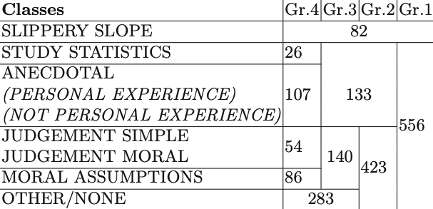
Detecting Opposition
datasets | Classes | Instances
Liga and Palmirani 2019 | Granular annotation | 638
most balanced granularity

Slide 40
Detecting Opposition
Classes | Dataset | TKs | LLM
Slippery Slope Other | Liga and Palmirani 2019 | .81(PTK)
Slippery Slope Testimony Other |  | .78 (PTK) | .87
Slippery Slope Testimony Moral Judgments Other |  | .71 (PTK)
Slippery Slope Anecdotal Study/Statistics Judgments Moral assumptions Other |  | .58 (PTK)
We tried TL with the most balanced granularity
*
Reference: Walton, D., Reed, C., Macagno, F.: Argumentation schemes. Cambridge University Press, 2008
Notes:
max 27m

Slide 41
Detecting argumentative Support and Opposition
NLP methods can detect argumentative structures of support and opposition.
This is relevant for argumentation.
Classifying argumentative support and argumentative opposition
(Liga and Palmirani 2020, “Transfer Learning with Sentence Embeddings for Argumentative Evidence Classification”)
Notes:
max 27m

Slide 42
Case study 2
Argumentative components
Sequence labelling of argumentative premises and conclusions in text
(Liga 2020, “Hybrid Artificial Intelligence to Extract Patterns and Rules from Argumentative and Legal Texts”)
Notes:
max 27m

Slide 43
Argumentative Sequence Labelling
Methods:
LLMs (fine-tuning)
Aims:
Connecting portions of text to portions of arg. structures
Task:
Sequence labelling task

Slide 44
Argumentative Sequence Labelling
Dataset:
The “Essay corpus” (Stab and Gurevych, 2017)
This corpus is composed of 402 persuasive essays written by students.
In the corpus we can find premises, claims and major claims (all the other sequence of text are considered non-argumentative).

Slide 45
Argumentative Sequence Labelling
Sequence Labelling means:
Labelling sequences of words (the same process used by NER classifiers)
President Mario Draghi knows
the rules of EU
O
PERSON
O
O
O
O
ORGANISATION

Slide 46
Argumentative Sequence Labelling
BIO format
(Beginning, Inner, Outer)
B
I
Mario Draghi knows
the rules of EU
B-PER
B-ORG
B-PER
I-PER
O
B
I-PER
I
I-ORG
O
O
O
B-ORG
O
B

Slide 47
Argumentative Sequence Labelling
BILUO format
(Beginning, Inner, Last, Unique, Outer)
B-PER
B-ORG
B
I
I
L
B
I-PER
I-ORG
Ursula von der Leyen knows
the rules of EU
I
B-PER
I-PER
I-PER
L-PER
O
L-PER
L
L-ORG
O
O
O
U-ORG
U-PER
U
U-ORG
O
U

Slide 48
Argumentative Sequence Labelling
XXX XXXX XX XXXXX.
Since XXX XXX XXX,
therefore XXX XXX XXX.
XXX XXXX , XXX XXXX XX XXXXX.
O
O
O
O
B-ARG
I-ARG
I-ARG
I-ARG
premise
B-ARG
I-ARG
I-ARG
I-ARG
B-ARG
conclusion
I-ARG
O
O
O
O
O
O
O

Slide 49
Argumentative Sequence Labelling
XXX XXXX XX XXXXX.
Since XXX XXX XXX,
therefore XXX XXX XXX.
XXX XXXX , XXX XXXX XX XXXXX.
O
O
O
O
B-ARG
B-ARG
I-ARG
I-ARG
L-ARG
premise
I-ARG
B-ARG
I-ARG
I-ARG
L-ARG
L-ARG
conclusion
U-ARG
O
O
O
O
O
O
O

Slide 50
Argumentative Sequence Labelling
Fine-tuning BERT
Task 1
- argumentative vs non-argumentative
Task 2
- premise vs claim vs non-argumentative
B-ARG
I-ARG
(L-ARG)
(U-ARG)
O
B-PREMISE
I-PREMISE
(L-PREMISE)
(U-PREMISE)
B- CLAIM
I- CLAIM
(L- CLAIM)
(U- CLAIM)
O

Slide 51
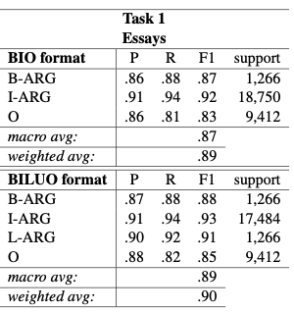
Argumentative Sequence Labelling
Results – Task 1
Notes:
max 30m

Slide 52
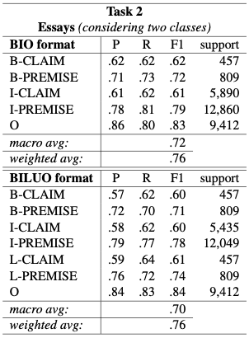
Argumentative Sequence Labelling
Results – Task 2

Slide 54
Argumentative Sequence Labelling
Transfer Learning can be used to perform Sequence Labelling of argumentative components such as premises and conclusions.
Sequence labelling of argumentative premises and conclusions in text
(Liga 2020, “Hybrid Artificial Intelligence to Extract Patterns and Rules from Argumentative and Legal Texts”)

Slide 55
Case study 3
Normative provisions
Sequence labelling of argumentative premises and conclusions in text
(Liga & Robaldo 2023, “Classifying norms via pre-trained language models: experiments on the DAPRECO-KB”)
Notes:
Max 32m

Slide 56
Detecting Rules and their deontic modality
Dataset:
707 legal provisions of the GDPR
Methods:
LLMs (fine-tuning), and also TKs
Legal Knowledge Representation
Aims:
automatic classification of rules and deontic modalities

Slide 57
Detecting Rules and their deontic modality
LegalRuleML
LegalXML standard for representing the logical rules of legal documents and connect them to their natural language representation
Logical/Inferential
Dimension
GDPR
Akoma Ntoso (LegalDocML)
LegalXML standard for representing the structure of legal documents, including not only their natural language but also many metadata
Legal document
structure
Athan et al., Oasis LegalRuleML (2013)
Robaldo et al., The dapreco knowledge base (2020)
Makinson and Van Der Torre, Input/output logics (2000)
Palmirani and Vitali, Akoma-ntoso for legal documents (2011)
LegalRuleML
DAPRECO
I/O Logic (DAPRECO’s logic)
Akoma Ntoso

Slide 58
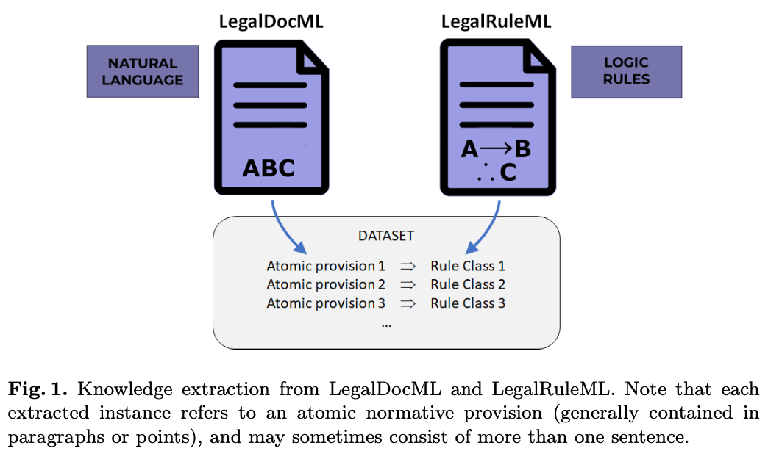
Detecting Rules and their deontic modality
Notes:
obligation
permission
constitutive rule

Slide 59
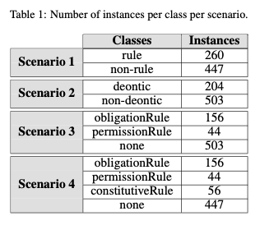
Detecting Rules and their deontic modality
The dataset:
Notes:
max 31m
obligation
permission
constitutive rule

Slide 60
Detecting Rules and their deontic modality
Notes:
Max 35m

Slide 61
Detecting Rules and their deontic modality
combining ML and Legal Knowledge Representation
Relevance for the legal domain:
We can classify rules and deontic modalities automatically.
This is a crucial connection between deontic logic and natural language processing.

Slide 62
Conclusion
LLMs can mine logical-inferential components from language
The distance between Mining and Reasoning is decreasing
Notes:
max 10m

Slide 63
THANKS
davide.liga@uni.lu
sana.nouzri@uni.lu
leon.vandertorre@uni.lu
liuwen.yu@uni.lu
Davide Liga
Leon van der Torre
Liuwen Yu

